Slide 1


SIT706 CLOUD COMPUTING
FINAL PROJECT
ALICE ANTONITA RAJA

Slide 2

BUSINESS SCENARIO
The company is experiencing annual doubling of demand for its shopping website.
Need for low latency and high availability of shopping cart data.
Implementing a serverless and event-driven approach.
Utilization of managed cloud services to reduce internal administration.
Investigating cost-efficient alternatives to a slow and expensive relational database.
Ensuring data encryption in transit and at rest.
Improving global response times due to expansion to other countries.
Meeting RPO of 15 minutes and RTO of 1 hour.

Slide 3


KEY REQUIREMENTS
Scalable and highly reliable
Low latency for user interacton
Serverless architecture
Managed services for efficiency
Cost-effective Database
Encyption of data for security
Performance Improvement
Recovery Objectives

Slide 4


PROPOSED SOLUTION
Use of AWS Global Accelerator, Route 53, and CloudFront for global distribution and low latency.
API Gateway and Lambda for a serverless backend.
Amazon S3 for static content storage.
DynamoDB for session management.
Amazon RDS (Aurora) for relational database needs.
ElastiCache for caching.
SNS/SQS for messaging.
IAM and KMS for security.
CloudWatch and CloudTrail for monitoring and logging.
AWS Backup for recovery.

Slide 5
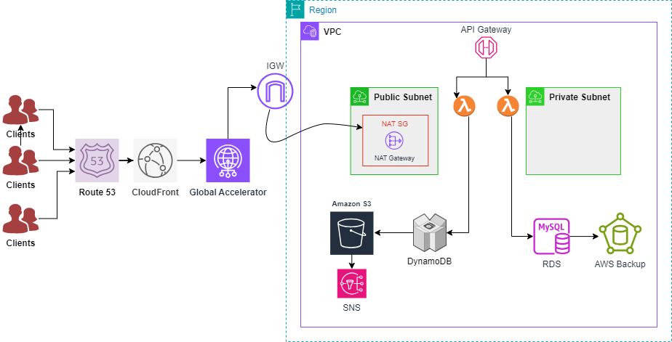
ARCHITECTURE DIAGRAM

Slide 6


IMPLEMENTATION STRATERGY
02
03
04
05
01
NETWORKING SETUP
APPLICATION SETUP
STORAGE AND DATABASE SETUP
SECURITY AND MONITORING
TESTING AND DEPLOYMENT
VPC, subnets, gateways, route tables
API Gateway, Lambda, Step Functions
IAM roles, KMS, CloudWatch, CloudTrail
Auto Scaling, Backup configurations
S3, DynamoDB, RDS, ElastiCache

Slide 7
REAL-WORLD IMPLICATIONS
Scalability: Supports increasing traffic without manual intervention.
Performance: Low latency and high availability enhance user experience.
Cost Efficiency: Optimized cost with managed services and serverless architecture.
Security: Robust data protection with encryption and access management.
Global Reach: Improved response times for international users.
Reliability: Meets stringent RPO and RTO requirements for business continuity.

Slide 8

THANK YOU

